Slide 1

Wire Detection using Computer Vision
Supervisor:
Dr. Riby A. Boby
Dr. Binod Kumar
By:
Udit Agarwal (B20ME076)
Abhishek Singh (B20ME005)

Slide 2
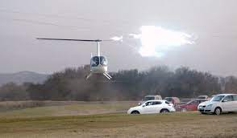
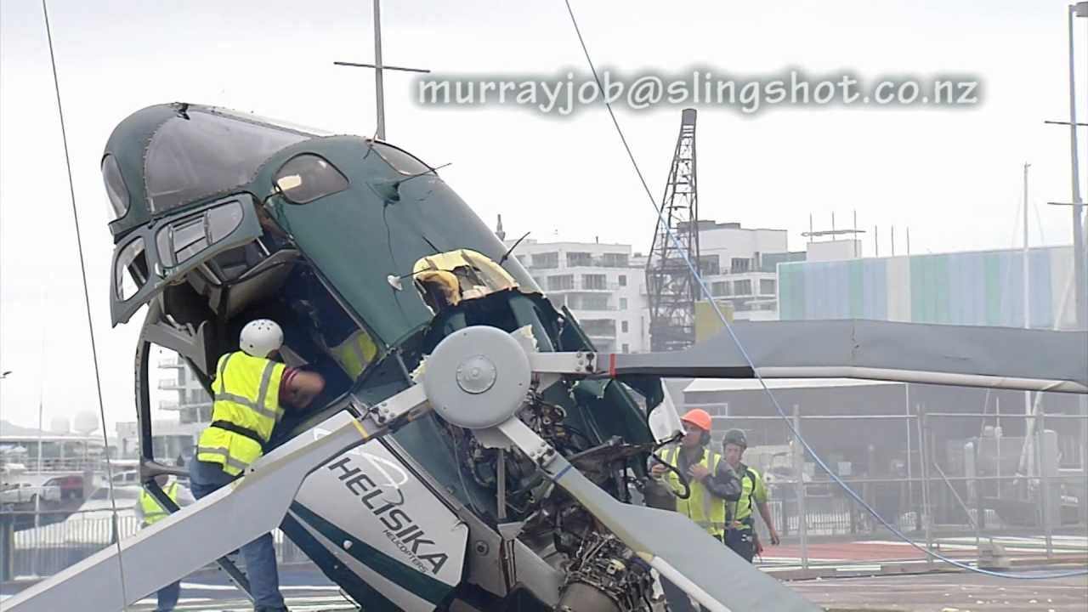
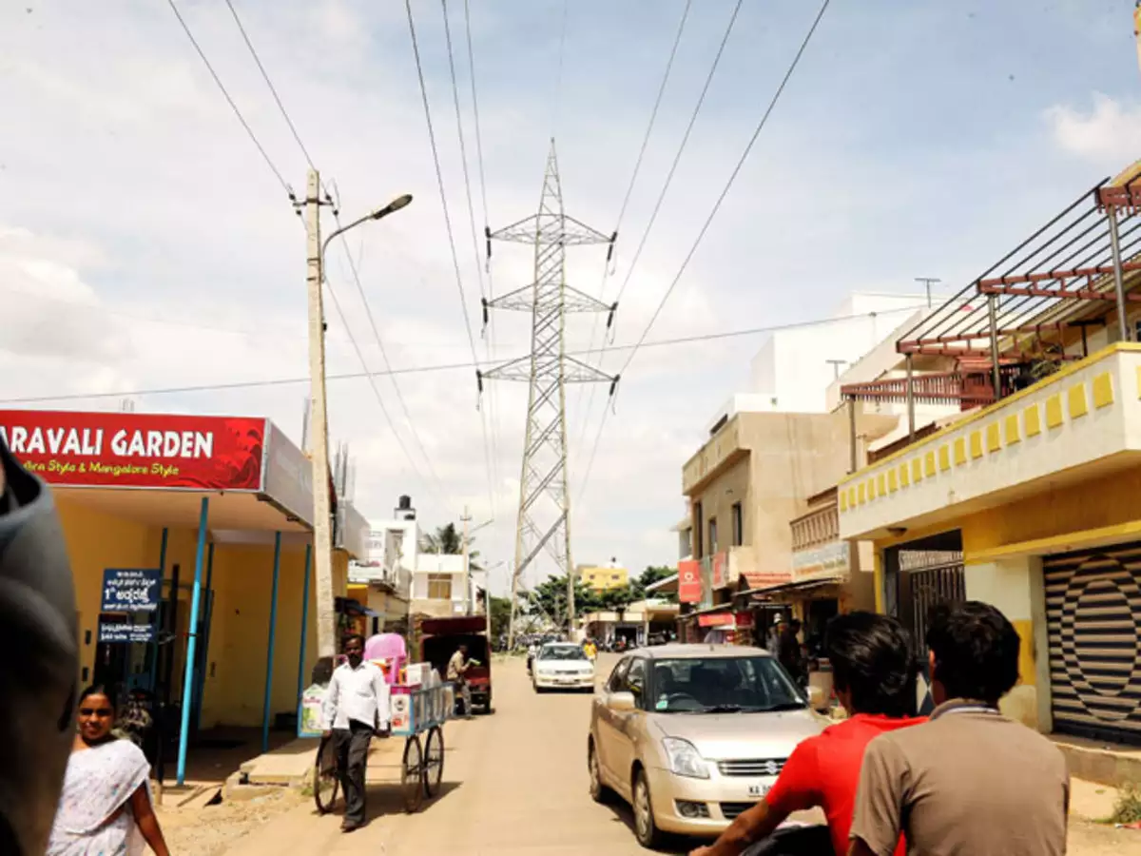
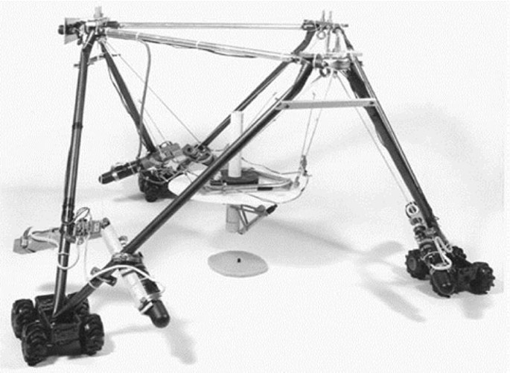
Introduction
Wire detection involves identifying and locating wires or cables, vital in applications like power line inspection, robotics & automation, and medical imaging.
Wire strikes: aviation incident where an aerial collides with wires, such as power lines or other cables though causing damage to life or infrastructure.
It accounts for 40% of the fatal accidents involving general aviation.
Cable driven robots: Identify and track the position, orientation, and movement of the cables, enabling precise control of the robot's motion and enhancing its adaptability in various environments.
Application:
Cable Inspection Industry:
India : 4,74,998 km of power lines
Drone Industry: Drone delivery operations are becoming increasingly popular in modern logistics operations.
USA : 8,00,000 km of power lines.

Slide 3
INITIAL APPROACH AND TASK
Literature review recent papers.
Finding the relevant datasets
Fitting the catenary equation
Camera calibration for final detection
Training the model
Running the model on edge device

Slide 4
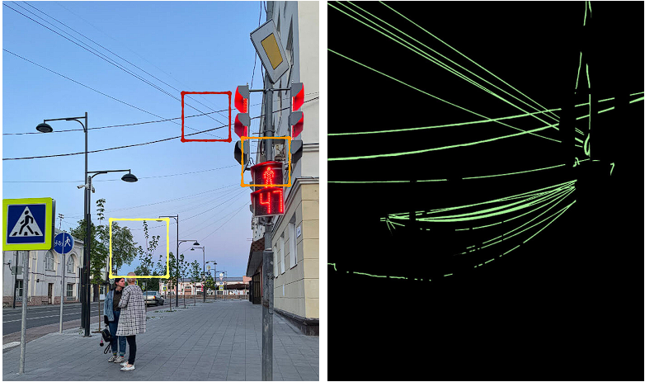
LITERATURE REVIEW
Wire Detection using Synthetic Data and Dilated Convolutional Networks for Unmanned Aerial Vehicles
The paper mentioned synthetic dataset, that was not shared and use of dilated CNN for wire detection.
Multi-view Reconstruction of Wires using a Catenary Model
Perform pixel-wise wire segmentation with a convolutional neural network(CNN)
Binarize the wire segmentation confidence maps by thresholding them
estimate the catenary model parameters via non-linear least squares optimization
Automatic High Resolution Wire Segmentation and Removal
The paper shares a dataset of its test images which are of natural images from ground perspective and wire segmentation

Slide 5
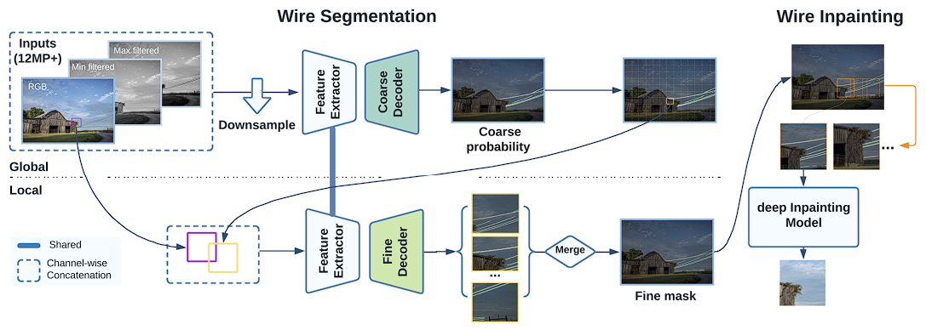
Continue
The paper also shares its model architecture to create such segmentation masks
TTPLA: An Aerial-Image Dataset for Detection and Segmentation of Transmission Towers and Power Lines
TTPLA is a public dataset which is a collection of aerial images on Transmission Towers (TTs) and Powers Lines (PLs).
Github : https://github.com/r3ab/ttpla_dataset

Slide 6
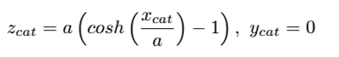
CATENARY EQUATION
A wire with uniform density and thickness, when suspended by its two ends under uniform gravity, follows the shape of the planar,single-parameter, catenary curve
Approach - Trying to use catenary equation, with the camera parameters to predict the exact wire shape.

Slide 7
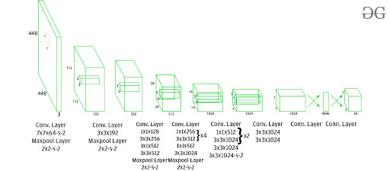
Choosing the right model : Yolo v8
YOLO is an acronym for a popular object detection algorithm called "You Only Look Once." YOLO is known for its efficiency in real-time object detection
Lightweight model: has only 13 million parameters.
Efficient and Robust : It achieves an mAP score of 52.8% on the COCO dataset at a speed of 60 FPS.
Designed for object detection specifically.
YOLO architecture

Slide 8
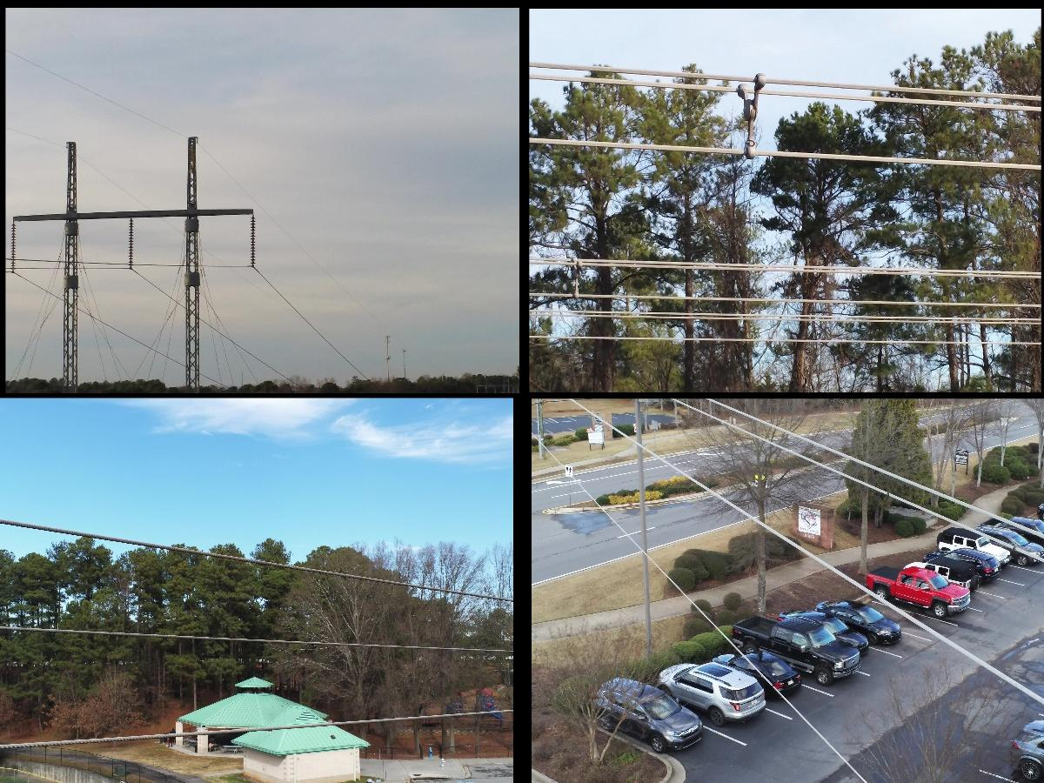
DATASET
Transmission Towers and Power Lines (TTPLA) is a public dataset which is a collection of aerial images covered from different angle of Transmission Towers (TTs) and Power Lines (PLs).
It contains a total of 2670 images
Having Resolution of (3840 x 2160) .
Sample of the dataset :

Slide 9

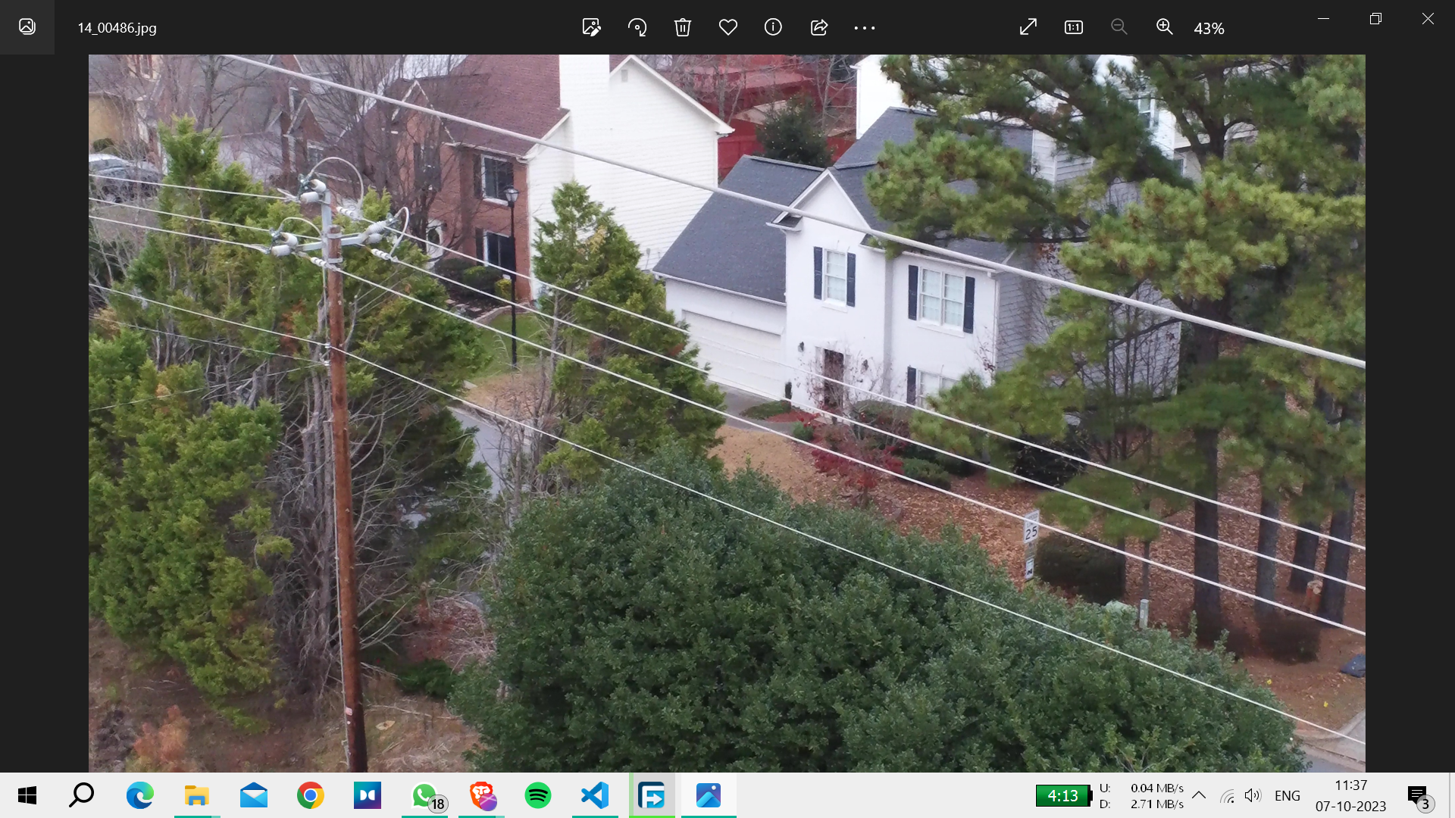
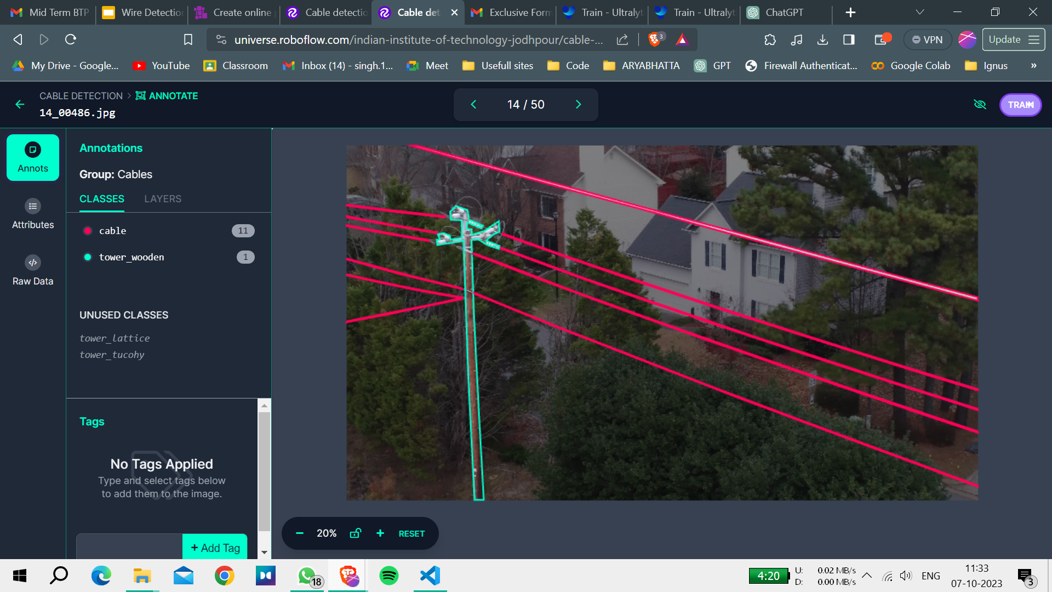
Data Preprocessing
We used Roboflow to annotate the images in four classes:
cable
tower_lattice
tower_tucohy
tower_wooden
Divided the dataset into Train, Validate and Test in the ratio 7:2:1.
Resize each image to 1280x1280.
Image on the left is annotated to image on right
Notes:
Now that we had our dataset. The next task we had was to label and annotate the images so that this can be fed to our segmentation model for training.

Slide 10
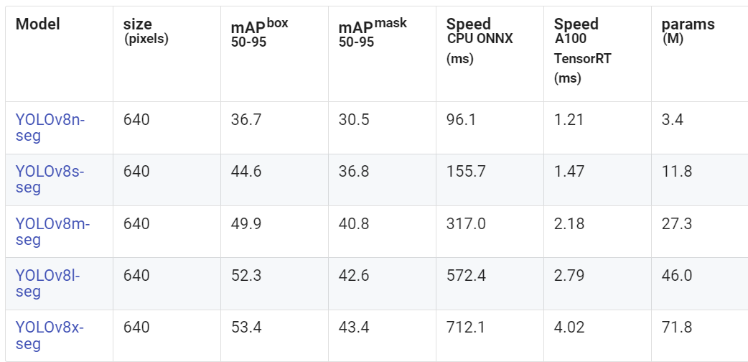
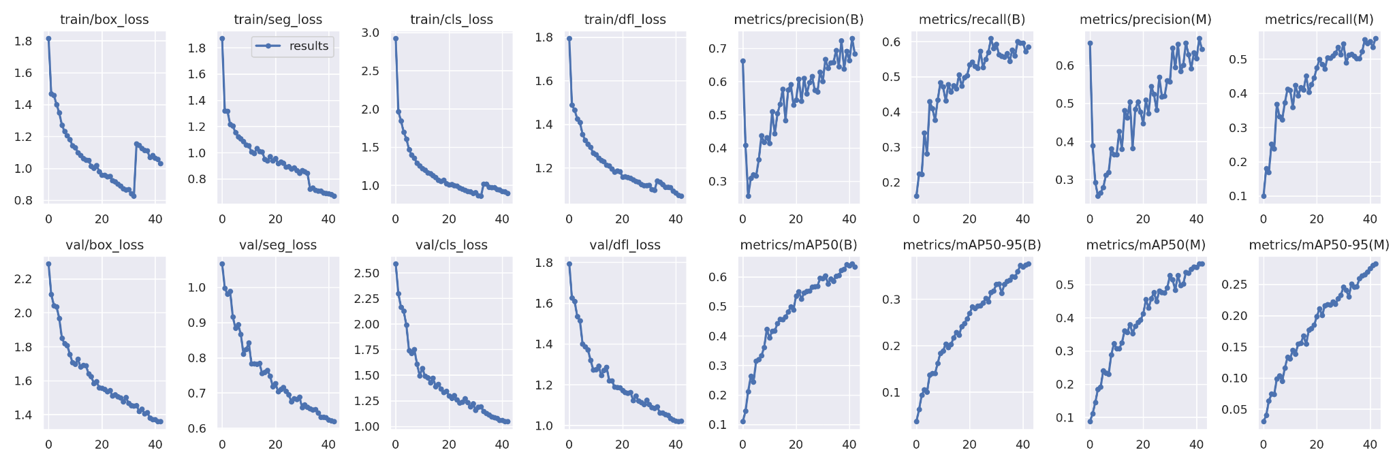
Model Training
We tried two different version of YOLO: nano and medium.
Then we performed iterative adjustments to optimize the model’s performance in wire detection. Evaluation metrics such as precision, segmentation loss, recall, and F1 score were utilized.

Slide 11
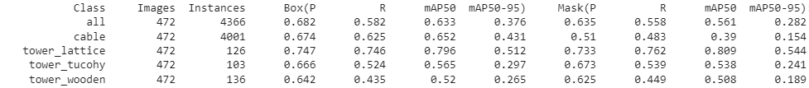
Results and Discussion
The results of our Yolov8-Medium model in wire detection demonstrate a promising performance, correctly identifying 69 out of 100 instances where wires were present.
On Nvidia T400 GPU, inference time per image of YOLOv8-medium was able to give an inference time of 31ms per image having dimension of (3840 × 2160).
The training required 110 GFlops of computation.

Slide 12
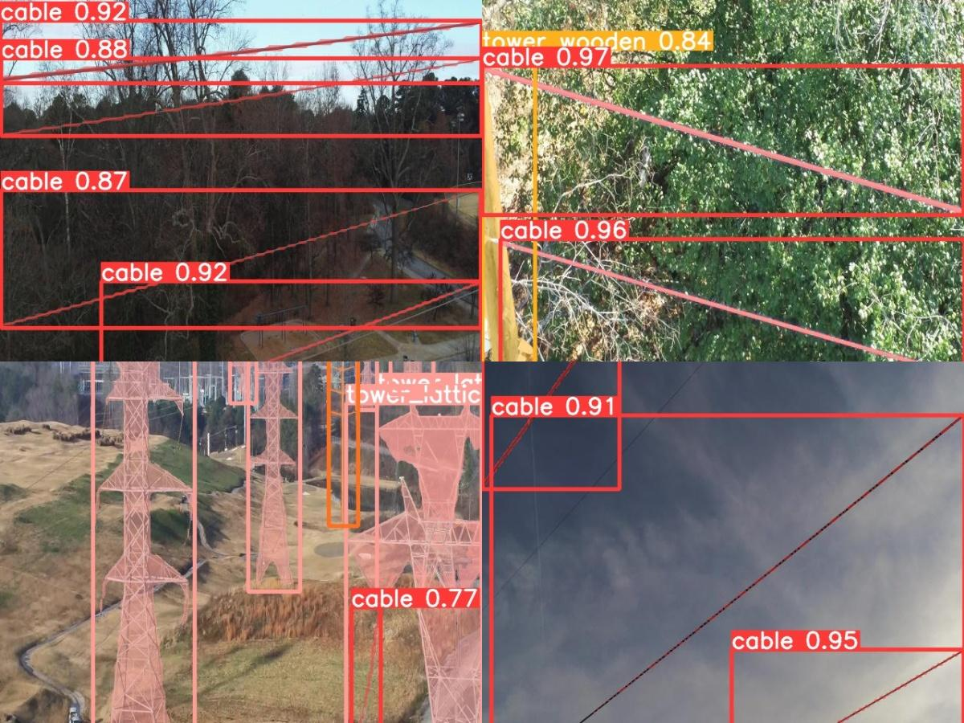
Prediction on Test:

Slide 13
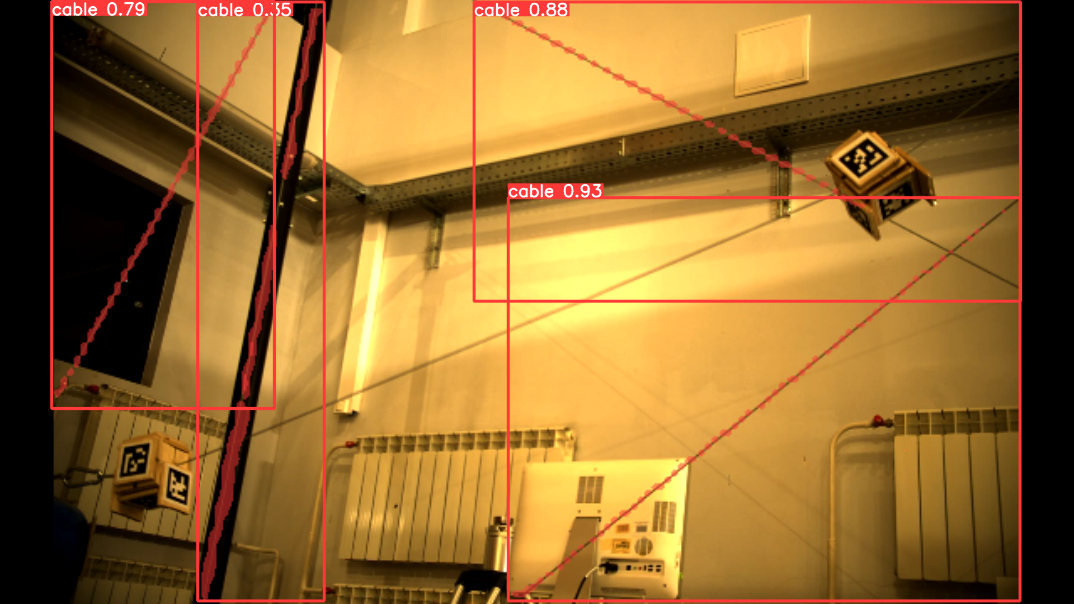
Prediction on Cable Driven Robot (from Lab)

Slide 14
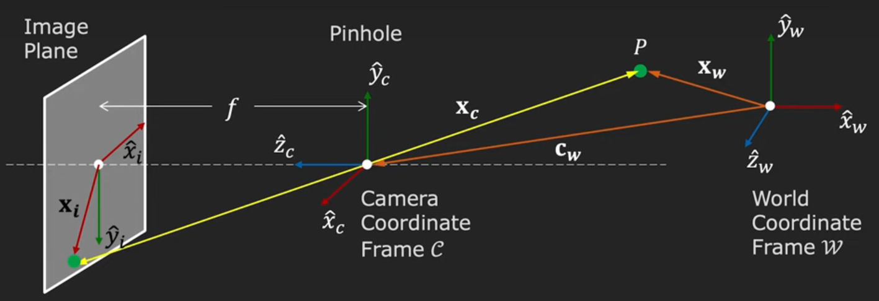
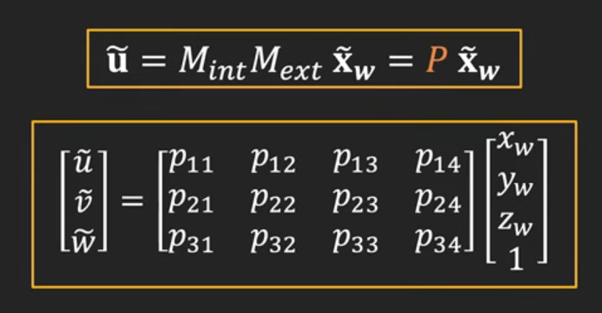
Forward Imaging Model : for implementing Catenary

Slide 15
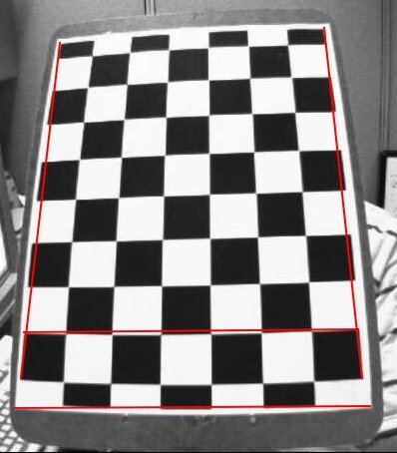
Camera Calibration:
Zang’s Method:
3D points are called object points and 2D image points are called image points.
For simplicity, we can say chess board was kept stationary at XY plane, (so Z=0 always) and camera was moved accordingly. This consideration helps us to find only X,Y values. Now for X,Y values, we can simply pass the points as (0,0), (1,0), (2,0), ... which denotes the location of points. In this case, the results we get will be in the scale of size of chess board square. But if we know the square size, (say 30 mm), we can pass the values as (0,0), (30,0), (60,0), ... . Thus, we get the results in mm.
Once the camera internals matrix C is known, the externals can be readily obtained

Slide 16
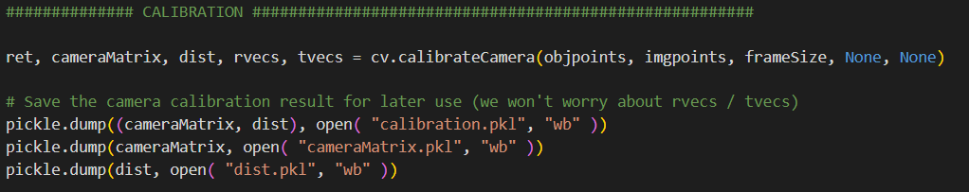
Using the following code we got the value of camera matrix:
Obtained Values:
Camera Matrix:
(array([[896.49048477, 0. , 318.25058791],
[ 0. , 894.62350573, 226.1312619 ],
[ 0. , 0. , 1. ]]),
Distortion Coefficient:
array([[-1.10737621e-01, 8.51838395e+00, -5.21910913e-04,
2.59887173e-03, -1.03951939e+02]]))

Slide 17
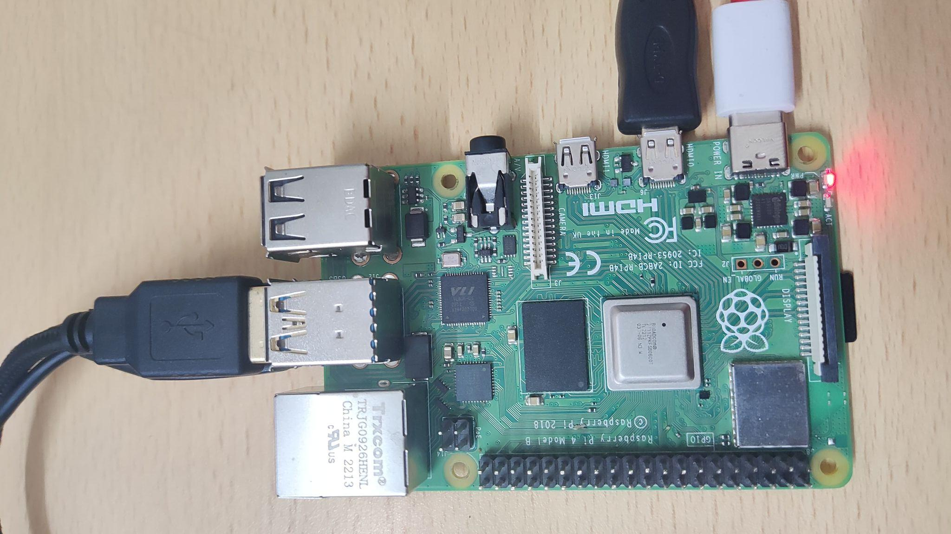
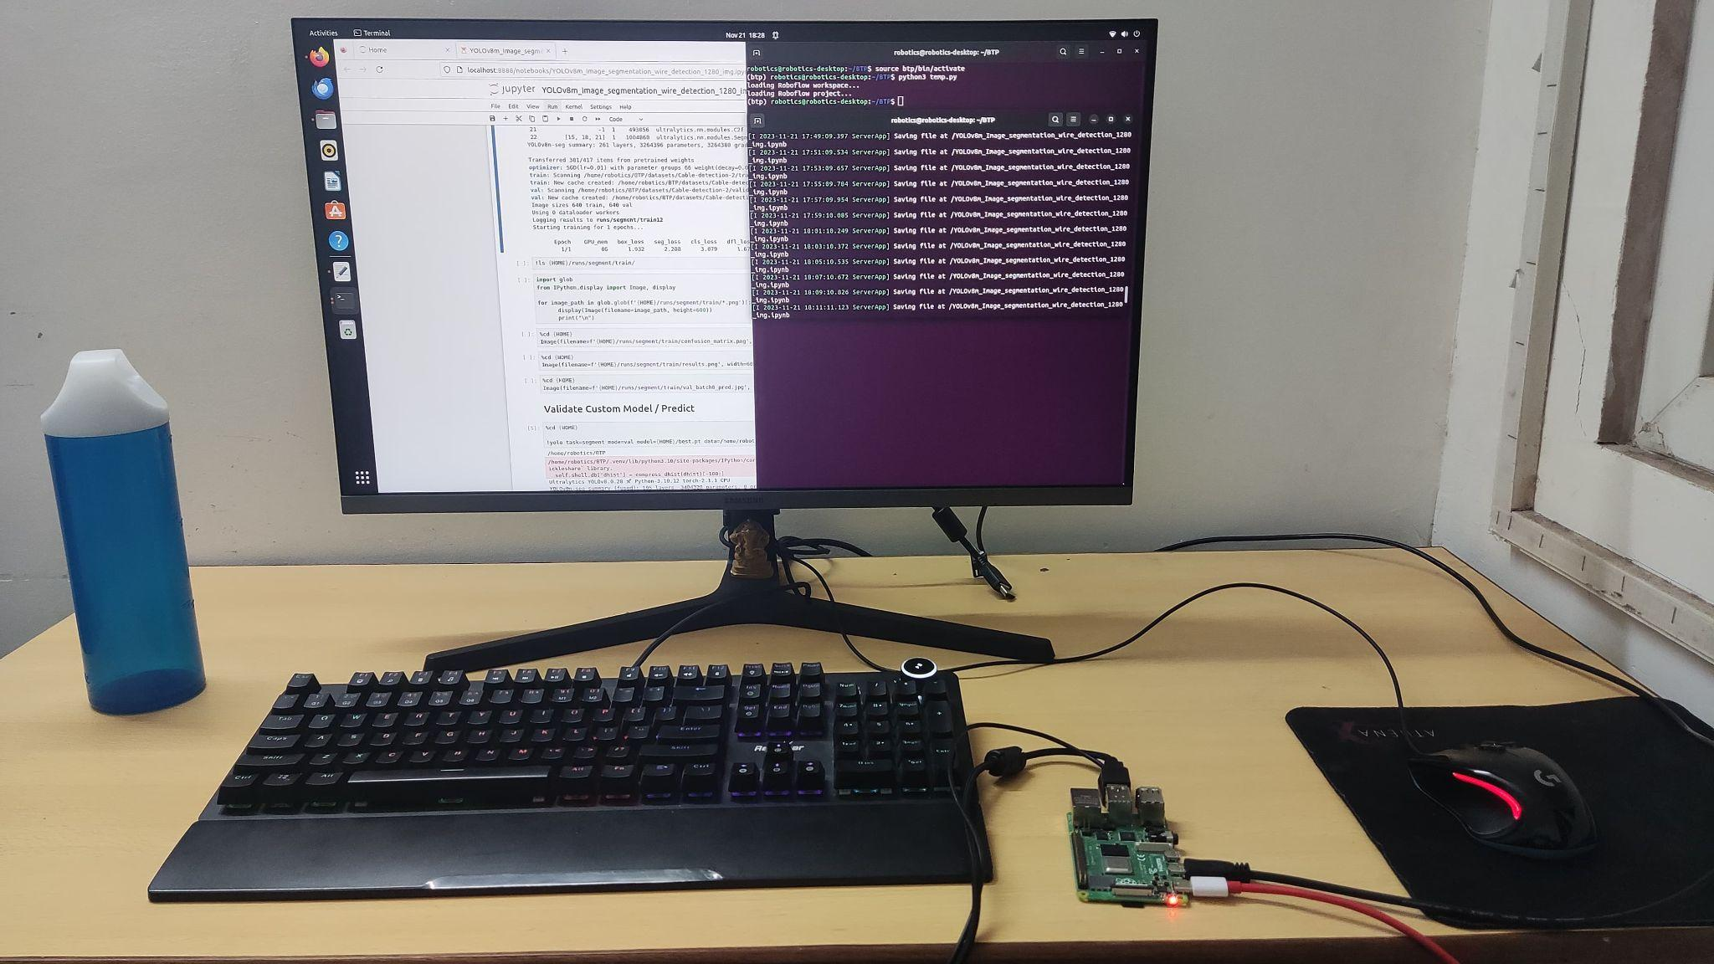
Edge Device Implementation
We used a Raspberry pi 4 Model B: 1 GB RAM for implementing it on edge devices. Pi 4 was Running on Linux

Slide 18
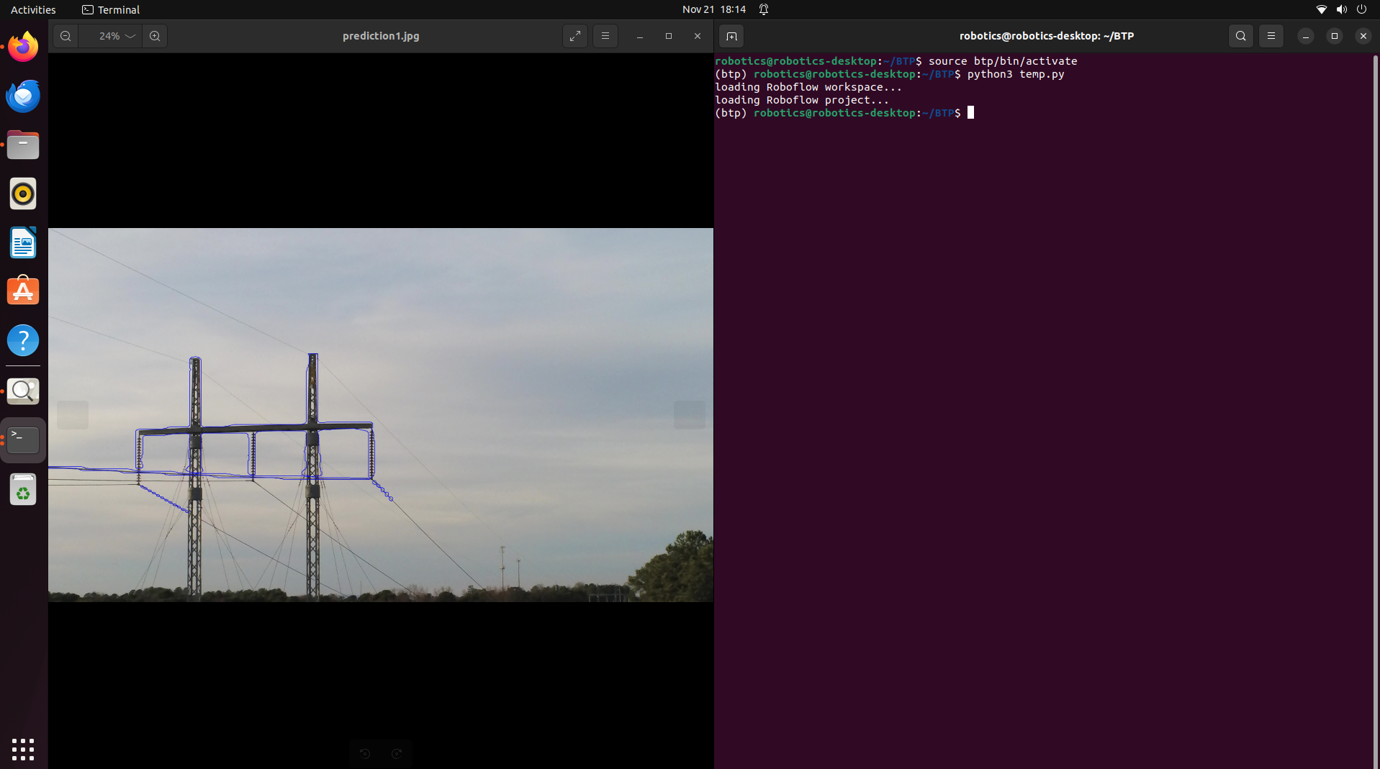
Running Model of Edge Devices
We ran our finetuned model on raspberry pi 4 to get the following results:

Slide 19
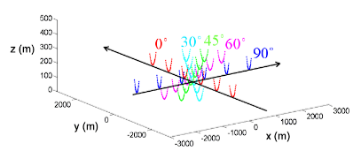
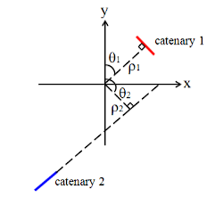
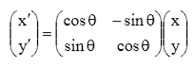
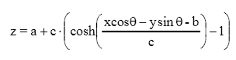
Mathematical Model for Catenary Estimation
Estimation Model :

Slide 20
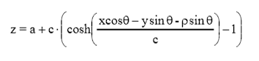
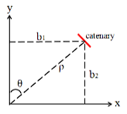
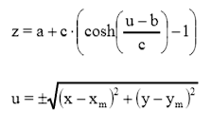
Model 2 :
Model 3 :

Slide 21
Conclusion
Enhanced Aerial Vehicle (UAV) safety
Help Cable driven robots to improve their accuracy in real life scenarios where cable lags due to catenary.
Although the project uses Computer Vision has its backbone, it has its application in Mechanical Engineering domain such as Robotics, Power Line Inspection etc.
Mechanical engineers play a crucial role in developing and maintaining infrastructure such as power lines and communication cables.
Notes:
The emphasis on real-time applicability and efficiency, especially on edge devices, brings in the aspect of embedded systems and mechatronics, which are integral parts of Mechanical Engineering.

Slide 22
References:
Camera calibration by Shree K. Nayar : Columbia University.
Wire Detection using Synthetic Data and Dilated Convolutional Networks for Unmanned Aerial Vehicles by Ratnesh Madaan∗, Daniel Maturana∗, Sebastian Scherer.
TTPLA dataset : https://paperswithcode.com/dataset/ttpla
https://github.com/ultralytics/ultralytics
https://roboflow.com/model/yolov8

